Slide 1


Kimathi University
Computer Society of Kimathi (CSK)
PHP MEETUP 2.0
Mutinda Boniface
Bsc. Information Technology
Object Oriented Programming - PHP
OOP- PHP

Slide 2
Overview of OOP
OOP? - What comes into your mind ?
Class..
Object.
Inheritance
Polymorphism
Data Hiding
Class..
Object..
OOP- PHP

Slide 3
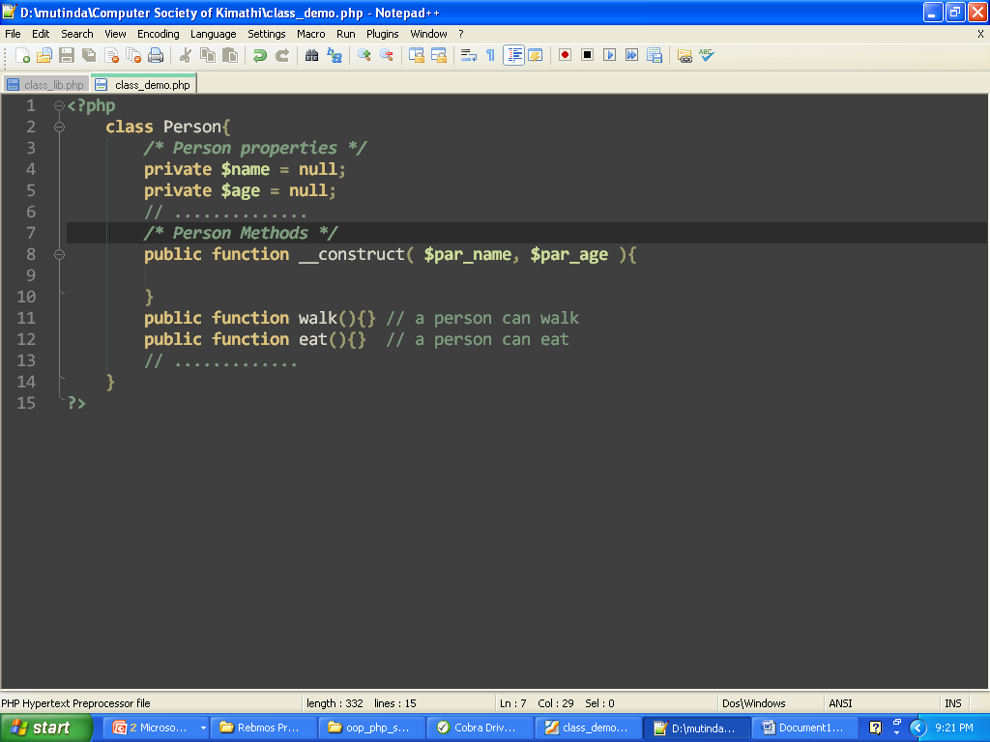
Overview of OOP Cont’
1. Class – A template that facilitates creation of objects,
- A set of program statements to do a certain task.
- Methods and properties
Example
Represents an entity in a real world
properties
constructor
methods
OOP- PHP

Slide 4
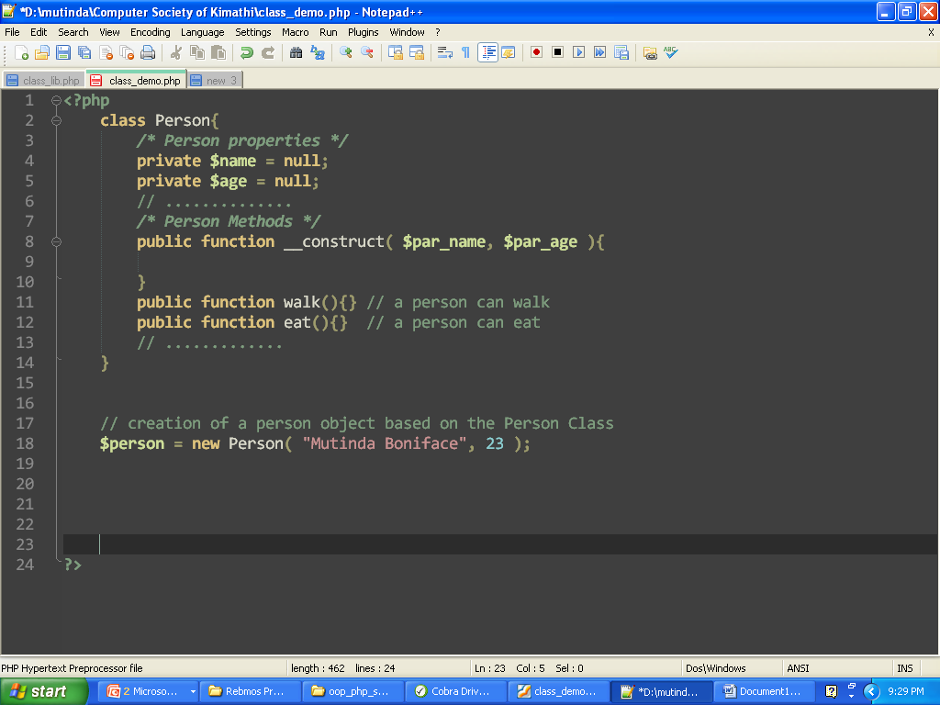
Overview of OOP Cont’
2. Object – Instance of a class
Example
Calls the class constructor if
It’s defined
object
new keyword to denote a new object of the class
OOP- PHP

Slide 5
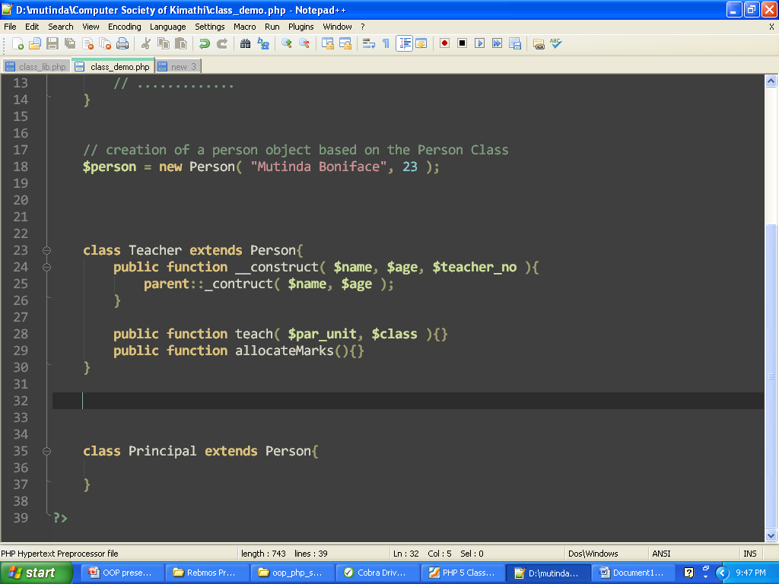
Overview of OOP Cont’
3. Inheritance – Parent and a child relationship
- Allows for reusability, extensibility
Nutshell: create a new class based on an existing class and port in to it new methods and then later on create new objects based on this class
Example
Inheritance is by the keyword extends in php
2 more methods
OOP- PHP

Slide 6
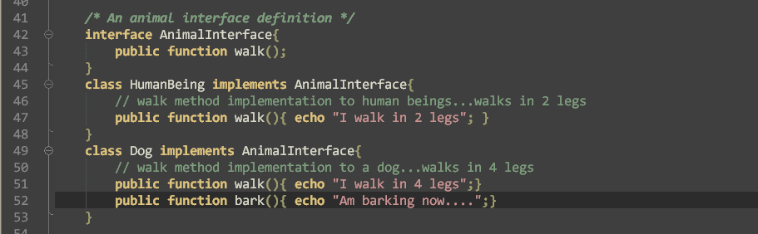
Overview of OOP Cont’
4. Polymorphism – Objects react different to the same message
- implemented using keyword interface
- Solution since php doesn’t support multiple
in heritance
Example
Human being is an animal Dog is an animal
Human being can walk + dog can walk and so on….
This models out an animal interface whose methods are implemented in classes which implements them
See walk()
Implementation for a human being
See walk()
Implementation for a dog
OOP- PHP

Slide 7
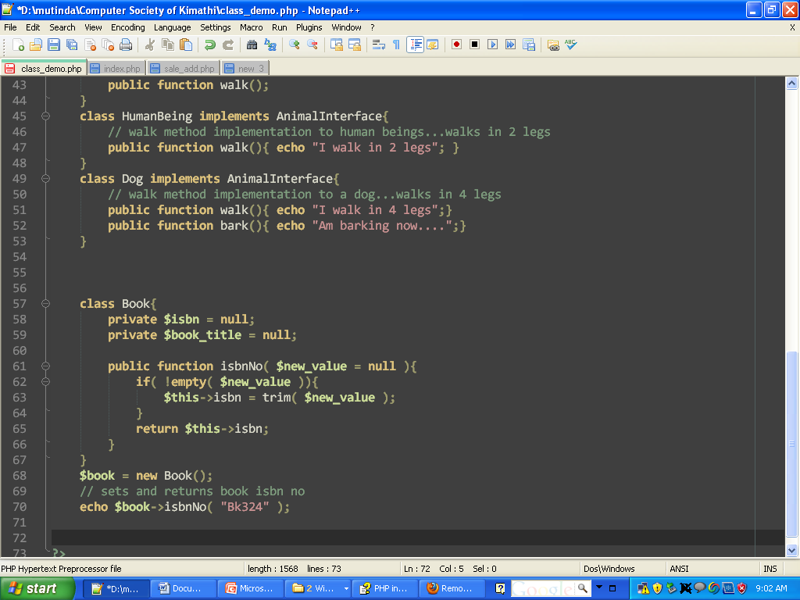
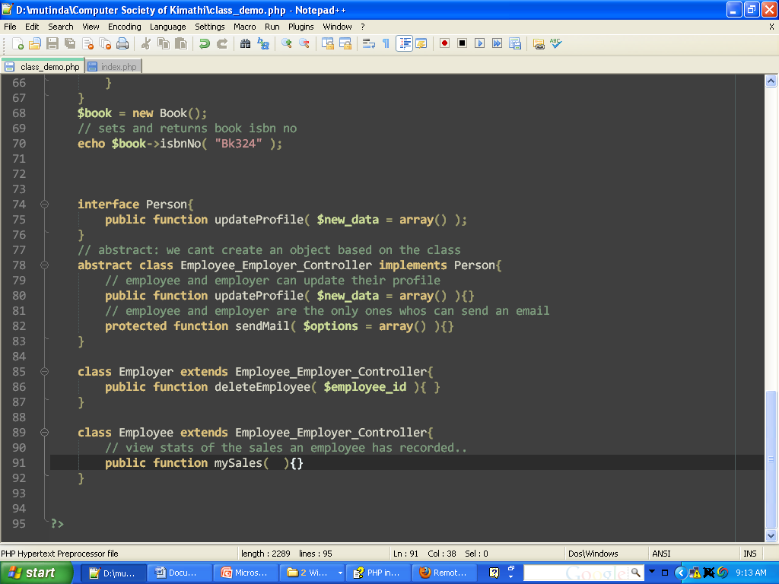
Overview of OOP Cont’
5. Data Hiding – Limiting variables within or outside an object
- Demonstrates access control modifiers…
- public, protected, private
Example
Public: member functions and properties defined as public are accessible
Within and outside the script.
Private: only accessible within the class it is defined in not outside
Protected: accessible within the class it is defined in and the descendants
Of the class.
This models out an animal interface whose methods are implemented in classes which implements them
See walk()
Implementation for a human being
See walk()
Implementation for a dog
OOP- PHP

Slide 8
Overview of OOP Cont’
PHP 5 magic Functions
__get(), __set(), __toString(), __clone(), ………
Example
__set() - it'll be called automatically by the PHP engine each time a script attempts to assign a value to a property of a class that hasn't been explicitly declared.
__get() - the "__get()" function will be invoked transparently when a script tries to retrieve the value of an undeclared class property as well.
This models out an animal interface whose methods are implemented in classes which implements them
See walk()
Implementation for a human being
See walk()
Implementation for a dog
OOP- PHP

Slide 9
OOP CODE DEMOS
Class keyword
Interface keyword
Implements keyword
Extends keyword
Magic functions __set(), __get(),…..
This models out an animal interface whose methods are implemented in classes which implements them
OOP- PHP

Slide 10
Questions?
?
OOP- PHP

Slide 11
Thanks
@mutinda – Rebmos Team
blog.rebmos.com
OOP- PHP

